Slide 1
Resleeve Assesment
Luca Brugaletta

Slide 2
PROJECT introduction
The project was created using the cookiecutter data science template
The packages that have been used are listed in requirements.txt and they are installed with conda.
The scripts that are in the main folder are:
test_pretrained.py : to infere the data from the test dataset
test_extdata.py: to preprocess and predict external images

Slide 3
test_pretrained.py
Mostly reuse the functions that were used in the CPVTON+.
It is readapted doing the inference of the 2 models (GMM,TOM) in a single run, reason why it includes the checkpoint params of both models.
When the inference is completed it calculates two statistics: structural similarity index and learned perceptual image similarity

Slide 4
test_extdata.py
This script requires the folder where the cloth and images are saved. In addition a txt file needs to be prepared with the pairs (person, cloth).
After taking all the paths of the raw image pairs from the label text file, it includes two main steps:
The first part processes the images with the function process_images. The results are listed in the processed folder, which will contain: normal images, masks and the keypoints.
to perform these operations i integrated graphonomy and openpose
On the other hand, the second function is make_try_on() that utilize the warper model and the try on module

Slide 5
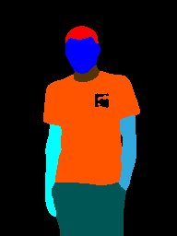
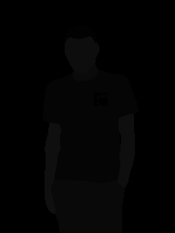
Graphonomy
Part of the Graphonomy project with the pretrained model are introduced to perfom human parsing.
The results are saved in image-parse and image-parse-new
The function to accomplish the results is located in graphonomy/inference.py and it is used inside test_exdata.py with the function inference() ~ line 100

Slide 6
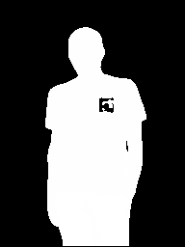
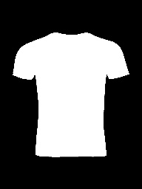
1)image-mask and cloth-mask
Both of the functions to obtain the masks are contained in src/data/build_image_mask.py
To create the image mask i used the body_mask function that was available in previous commit of the cp-viton-plus. the input comes from graphonomy’s output (grayscale segmented image)
To create the cloth mask I have done it using binary thresholdig, where i get an initial mask that gets filled, applying noise removal and erosion. I did a bit of try and error and I adopted the thresholding parameters that were looking better

Slide 7
openpose API
The folder openpose_api comes from the passages made to build their api.
The file that allows me to interact with the api is openpose_api/keypoints_from_images.py with the function find_keypoints(). After exposind the api the integration was streaightforward and the main adjustments were to set the parameters.
Lastly. after being saved in data/preprocessed/pose the json files are then renamed to match the naming of the initial files.
the paths are not teste

Slide 8
2)warp cloth and warp masks
After obtaining all the images needed to use the GMM model, I follow the same structure for the CP dataset and feed the input to the GMM model.
The warped images are then moved to the processed folder to obtain the final try on results

Slide 9
Metrics
The metrics are implemented according to their official implementation, but they looks far from their paper, the approach that I used, involves the use of the virtual tryon compared with the groundtrugh. According to the paper and some issues found on the github repository it should be the proper approach.
SSIM: 0.7435
LPIPS: 0.2677

Slide 10
How to deploy a model?
The easy way, Github. This is the way I adopted. Sadly, I don’t have experience with other approaches. Steps required to deploy a project with github is to create a virtual environment, share all the libraries that are adopted in a txt or yml file and the code
The proper way, Docker “Simply”, downloading an image and creating a container. Make easy to share and test a model in different environment. This would involve testing the openposi api on ubuntu, that I was not able to test.

Slide 11
About the test
I enjoyed making the test and It was a way to go out of my routine. There are still things that can be implemented and improved in project but they require time. I believe that what i did represent me and my approach

